Slide 1
Electric Ship Power and Energy System Architectures
Dr. Norbert Doerry
Dr. John Amy Jr.
IEEE ESTS 2017 August
(Revision of April 7, 2026)

Slide 2
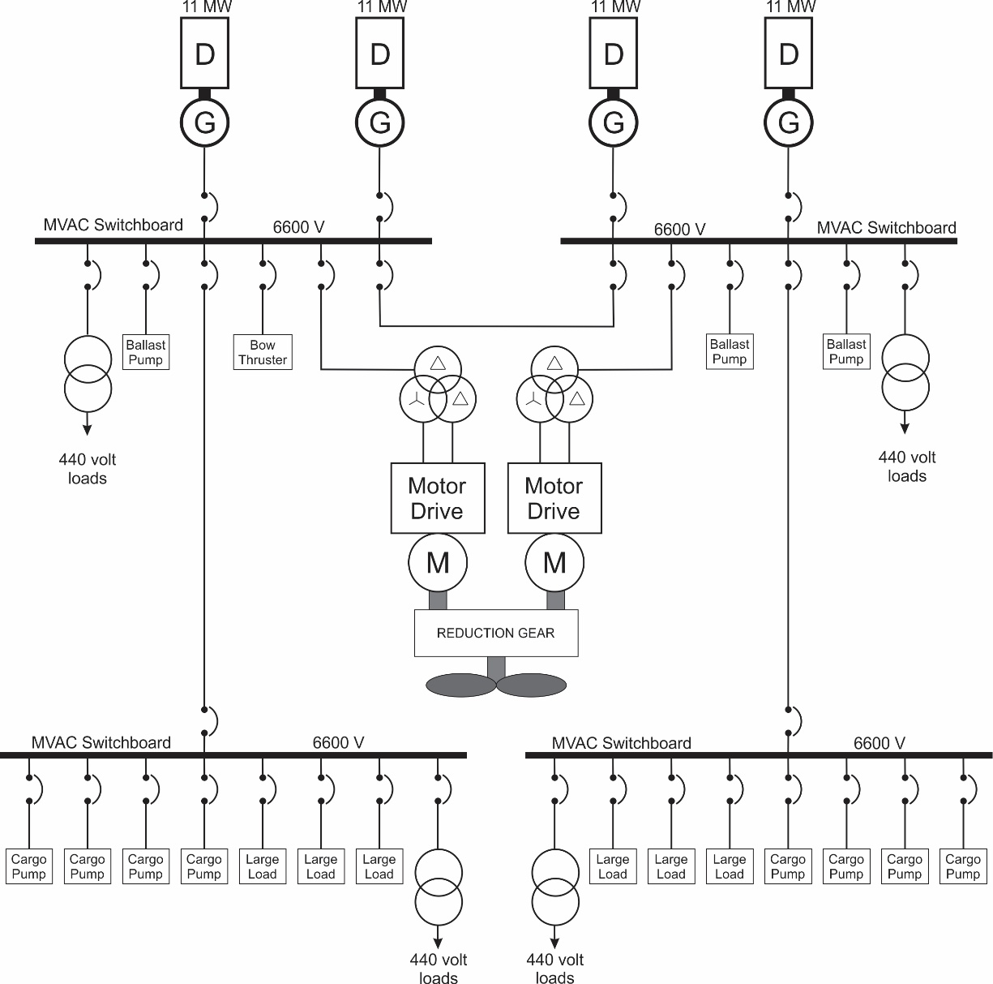
Liquefied Natural Gas (LNG) Carrier

Slide 3
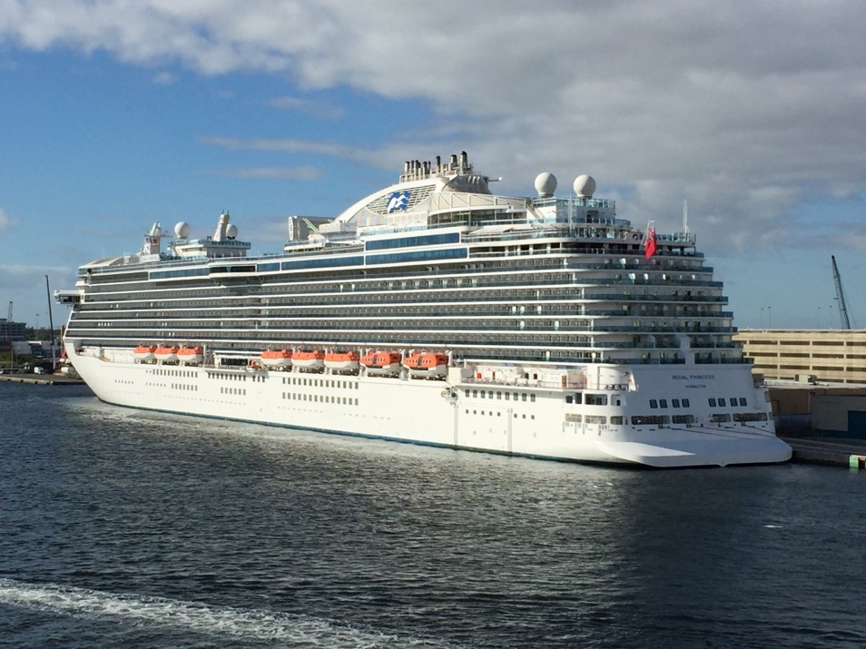
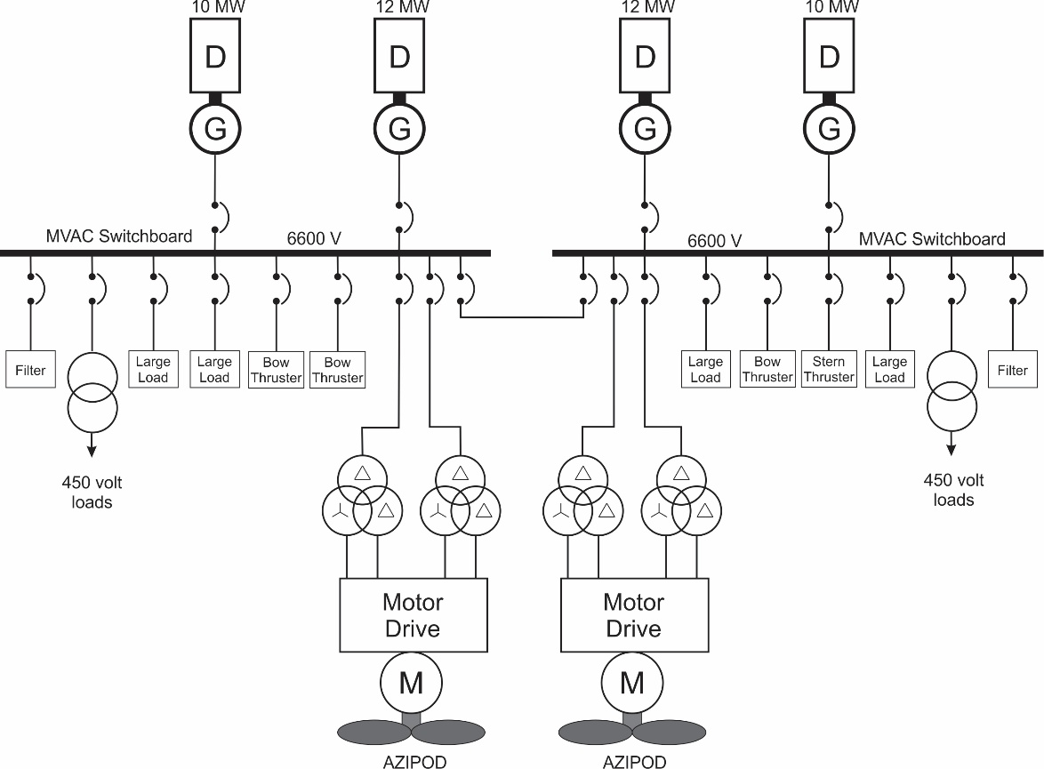
Cruise Ship
Regal Princess (Photo by Norbert Doerry)
(https://creativecommons.org/licenses/by/4.0/)

Slide 4
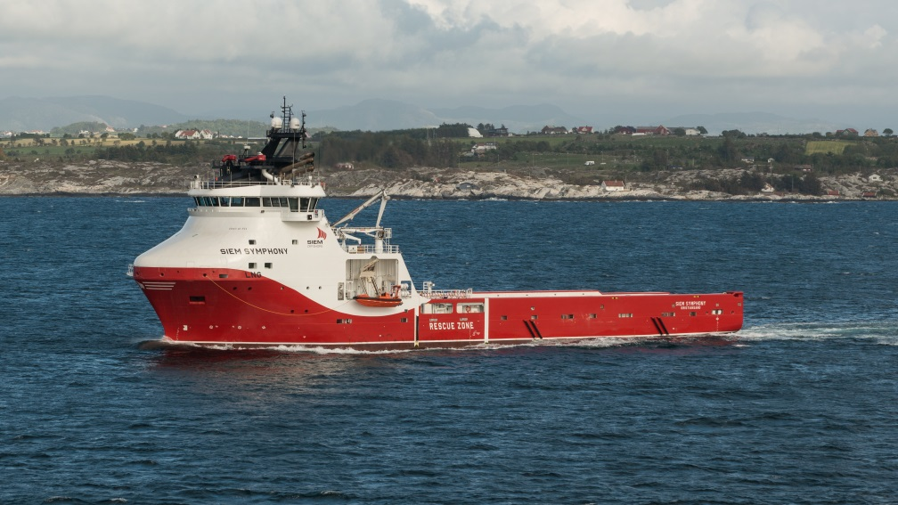
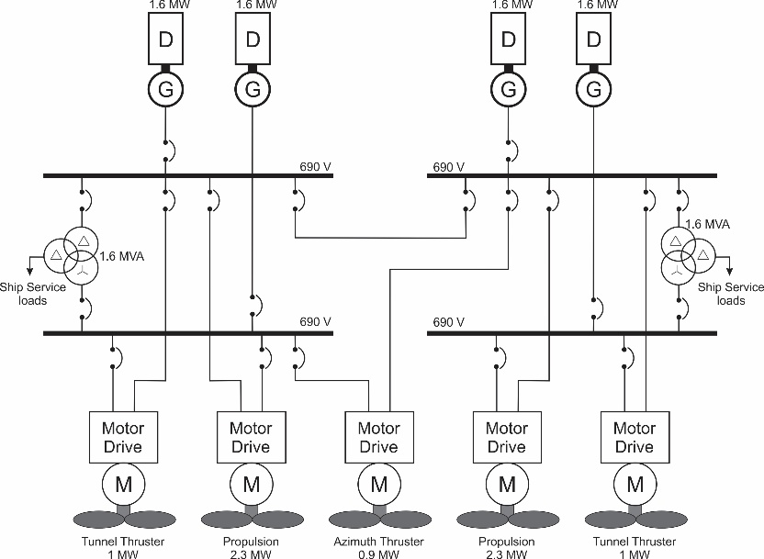
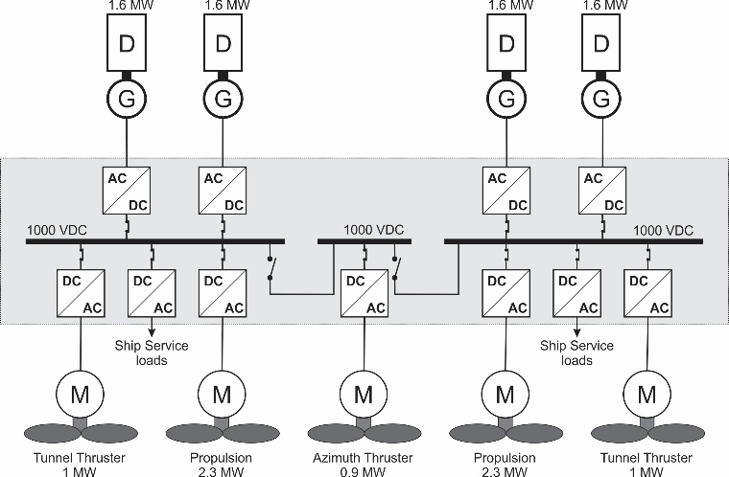
Platform Supply Vessel
Siem Symphony (photo by DXR: https://creativecommons.org/licenses/by-sa/4.0/)

Slide 5
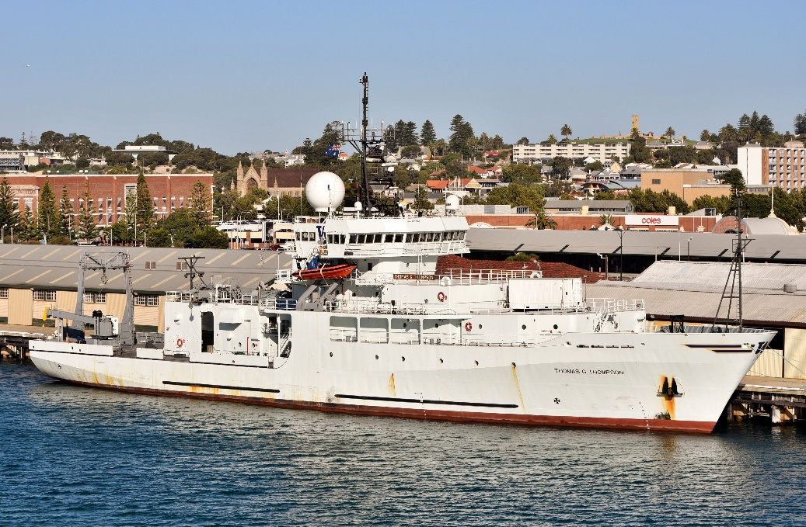
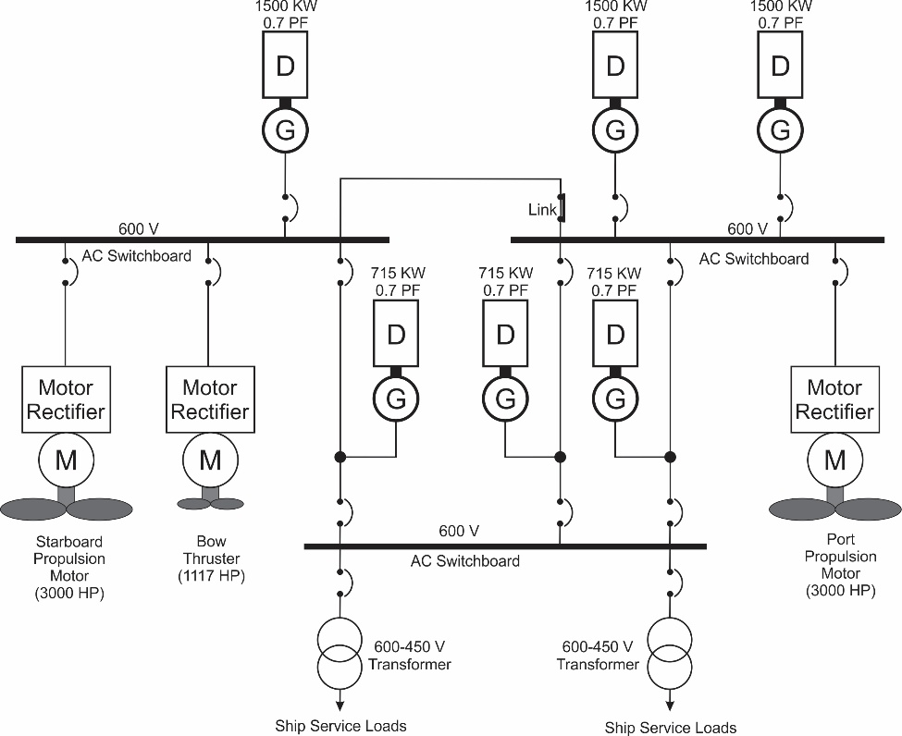
T-AGOR 23 Thomas G. Thompson
photo by Bahnfrend: https://creativecommons.org/licenses/by-sa/4.0/

Slide 6
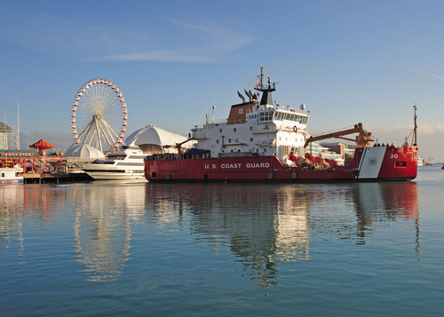
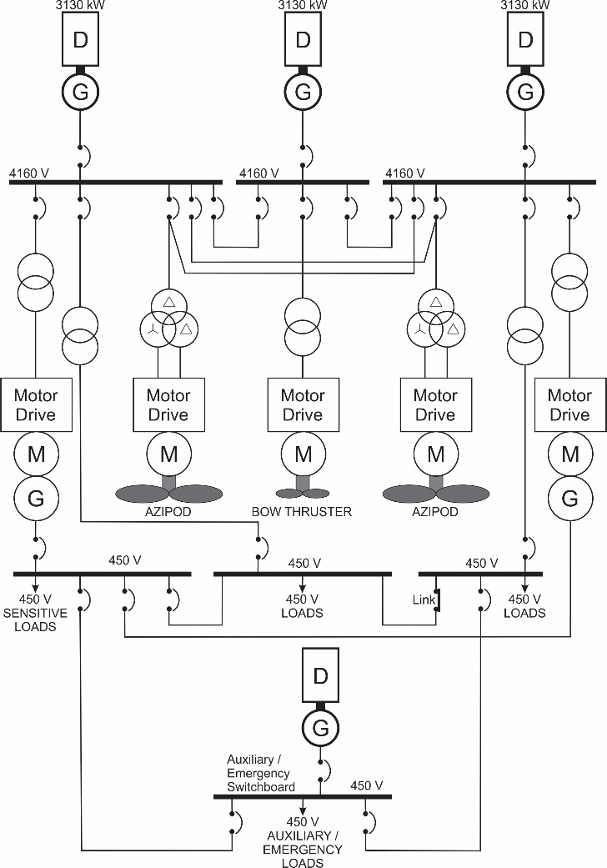
WLBB 30 USCGC Mackinaw
USCGC Mackinaw (WLBB 30) (US Coast Guard Photo by PA3 George Degener)

Slide 7
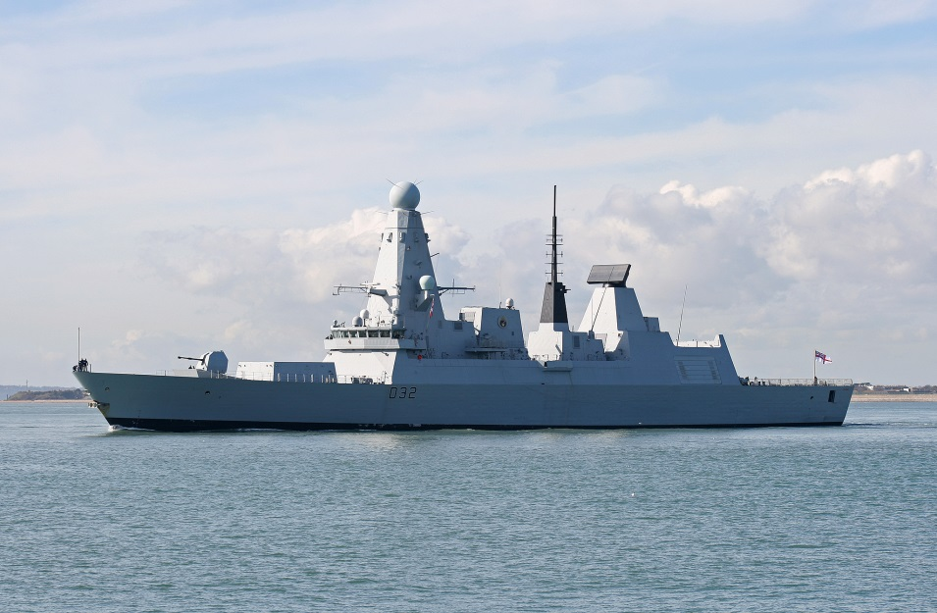
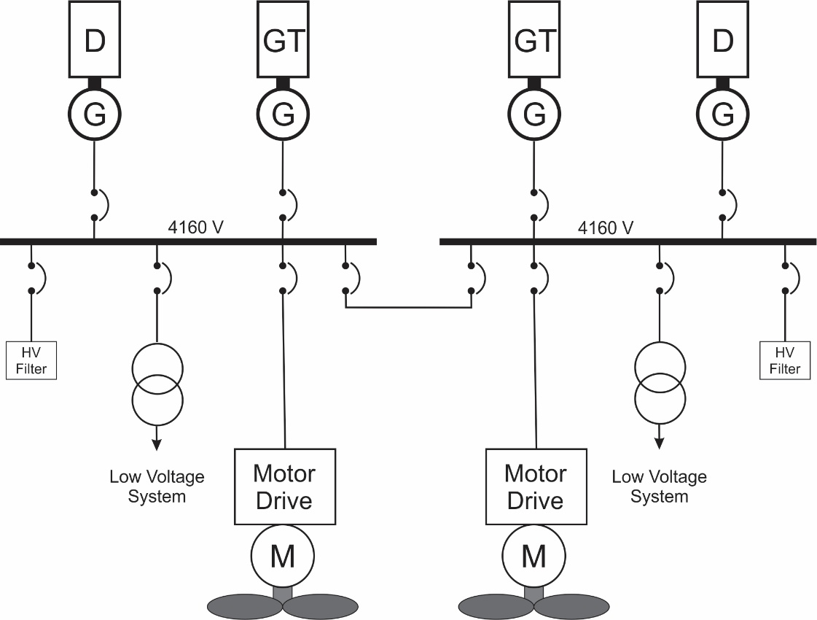
HMS Daring
HMS Daring (CC-BY-SA-3.0/Brian Burnell)

Slide 8
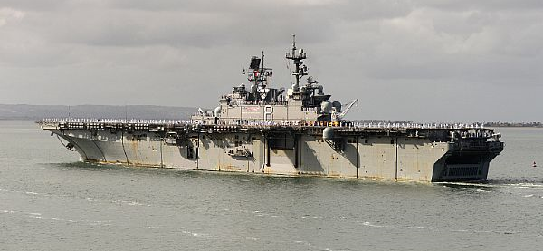
USS Makin Island LHD 8
US Navy photo by Brett A. Anderson
Thomas Dalton, Abe Boughner, C. David Mako, and CDR Norbert Doerry, "LHD 8: A step Toward the All Electric Warship", presented at ASNE Day 2002.

Slide 9
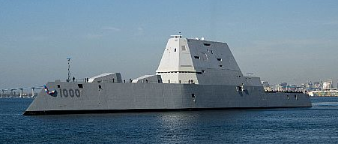
USS Zumwalt DDG 1000
US Navy Photo by Zachery Bell
Sposato, Bill, “DDG 1000 Class Destroyer” Presented to U.S. Navy Port Engineers, 31 August 2011

